Slide 1
Mapping the spatial distribution of urban traffic congestion: methodological exploration using web based services
Cohen, Jonathan¹
Gil, Jorge²
^{1, 2} Chalmers University of Technology, Sweden)
November 2020

Slide 2
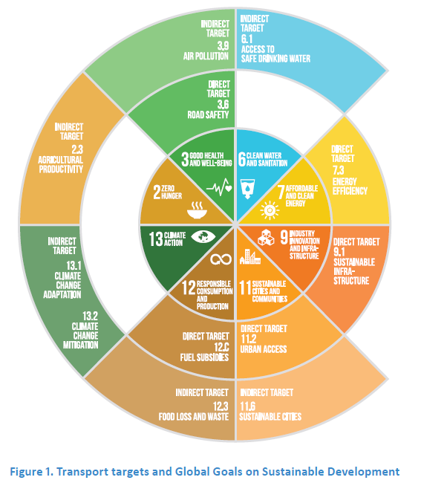
Role of mobility to achieve SDGs
Transport systems are important to achieve several SDGs.
Direct relation to targets: 3.6, 7.3, 9.1, 11.2
Indirect relation to targets: 2.3, 3.9, 6.1, 11.6, 12.3, 13.1 & 13.2
Booth, Hanmer, and Lovell (2000). SLoCaT (2015)

Slide 3
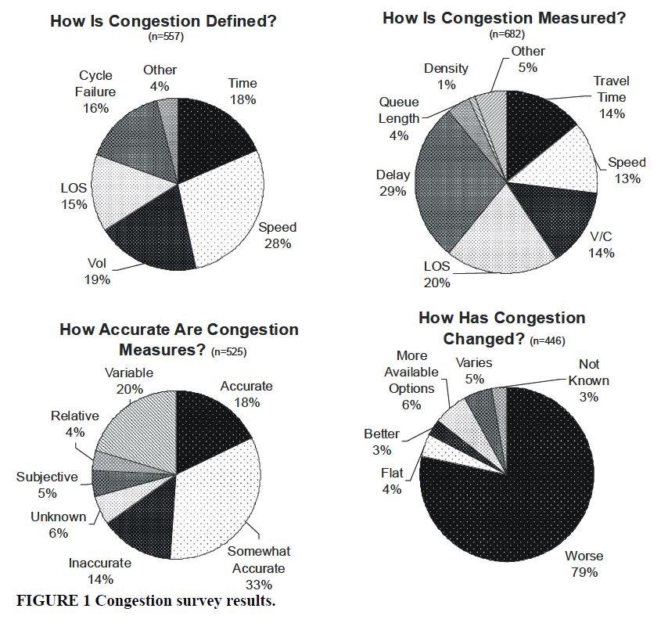
The problem of congestion
Time, speed, LOS and many other variables are used to define congestion.
Congestion can be measured in a variety of ways
18% think that the measures are accurate (33% somewhat accurate).
80% of transportation professionals believe that congestion problems has worsen.
Bertini, Robert L. (2005).
Notes:
We provide another perspective that shows who are the victims of congestion

Slide 4
Congestion costs
As a result of congestion, travel time, energy consumption and environmental cost will continue rising
Conservative estimates indicate that for every 1km/h increase in private cars and by 0.5 km/h are worth 0.1% of the Gross Domestic Product (GDP)
Social costs such as health related issues
Bull 2004; Diakaki, Kotsialos, and Wang (2003)
Thomson (2000)
Notes:
There is also a social cost

Slide 5
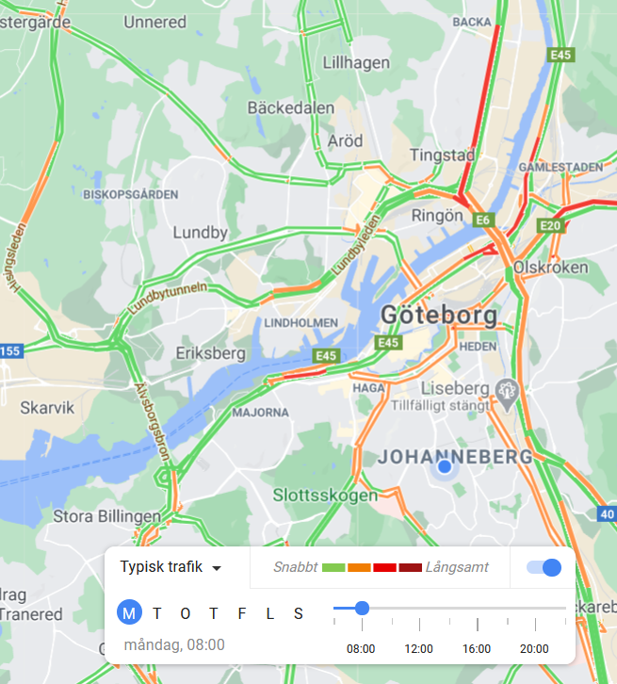
Objective
The aim of this research is to provide a reproducible methodology to measure how the problem of congestion is distributed across an urban area.
A new map of congestion can provide useful information to local authorities and planners to assess the impact on residents.

Slide 6
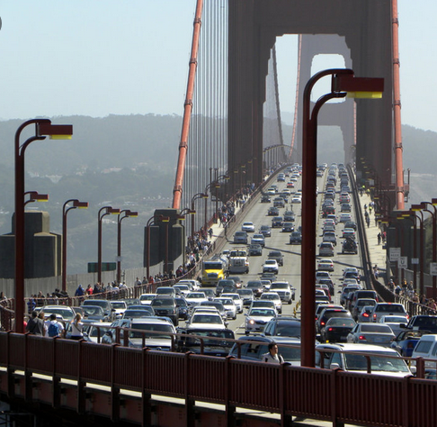
Objective
The aim of this research is to provide a reproducible methodology to measure how the problem of congestion is distributed across an urban area.
A new map of congestion can provide useful information to local authorities and planners to assess the impact on residents.
Where does this citizen live?

Slide 7
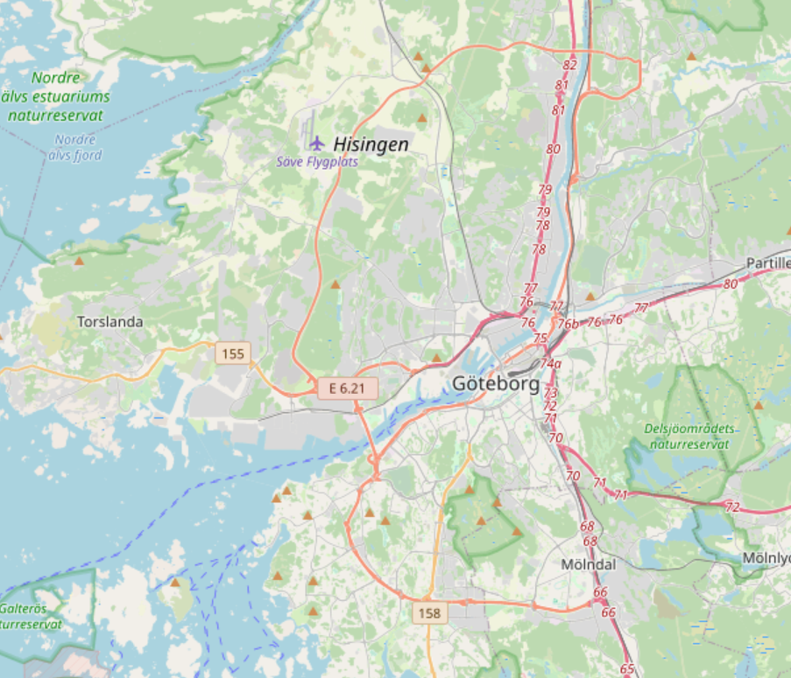
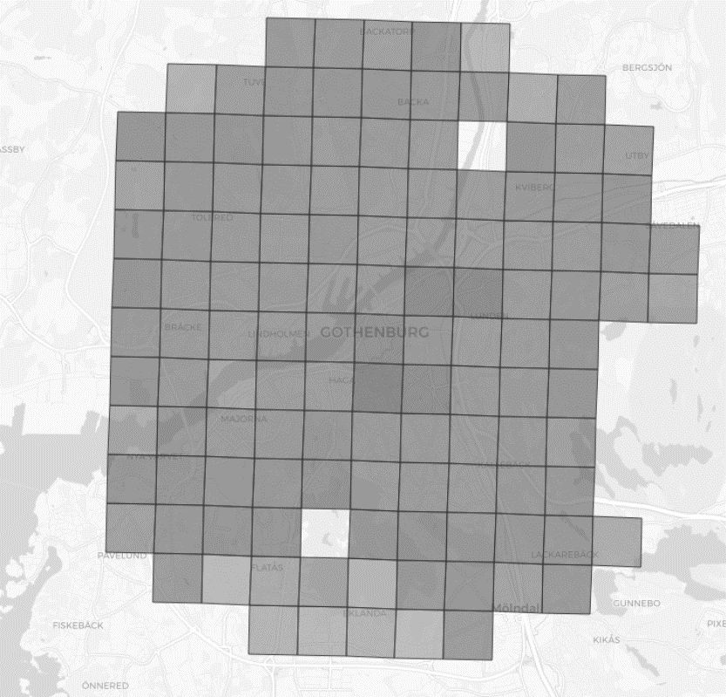
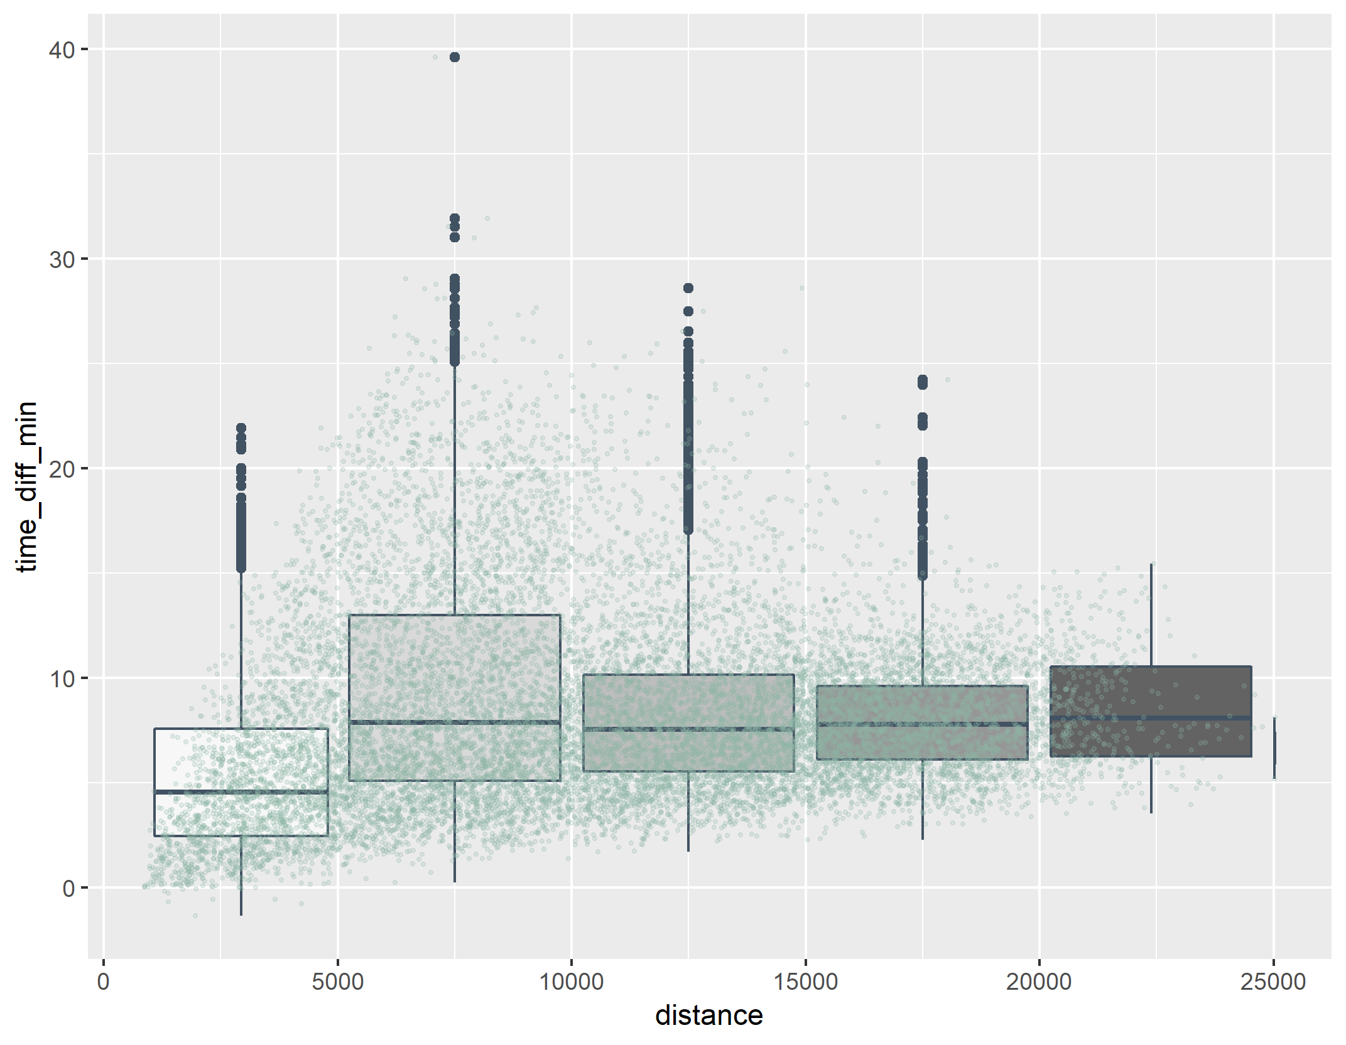

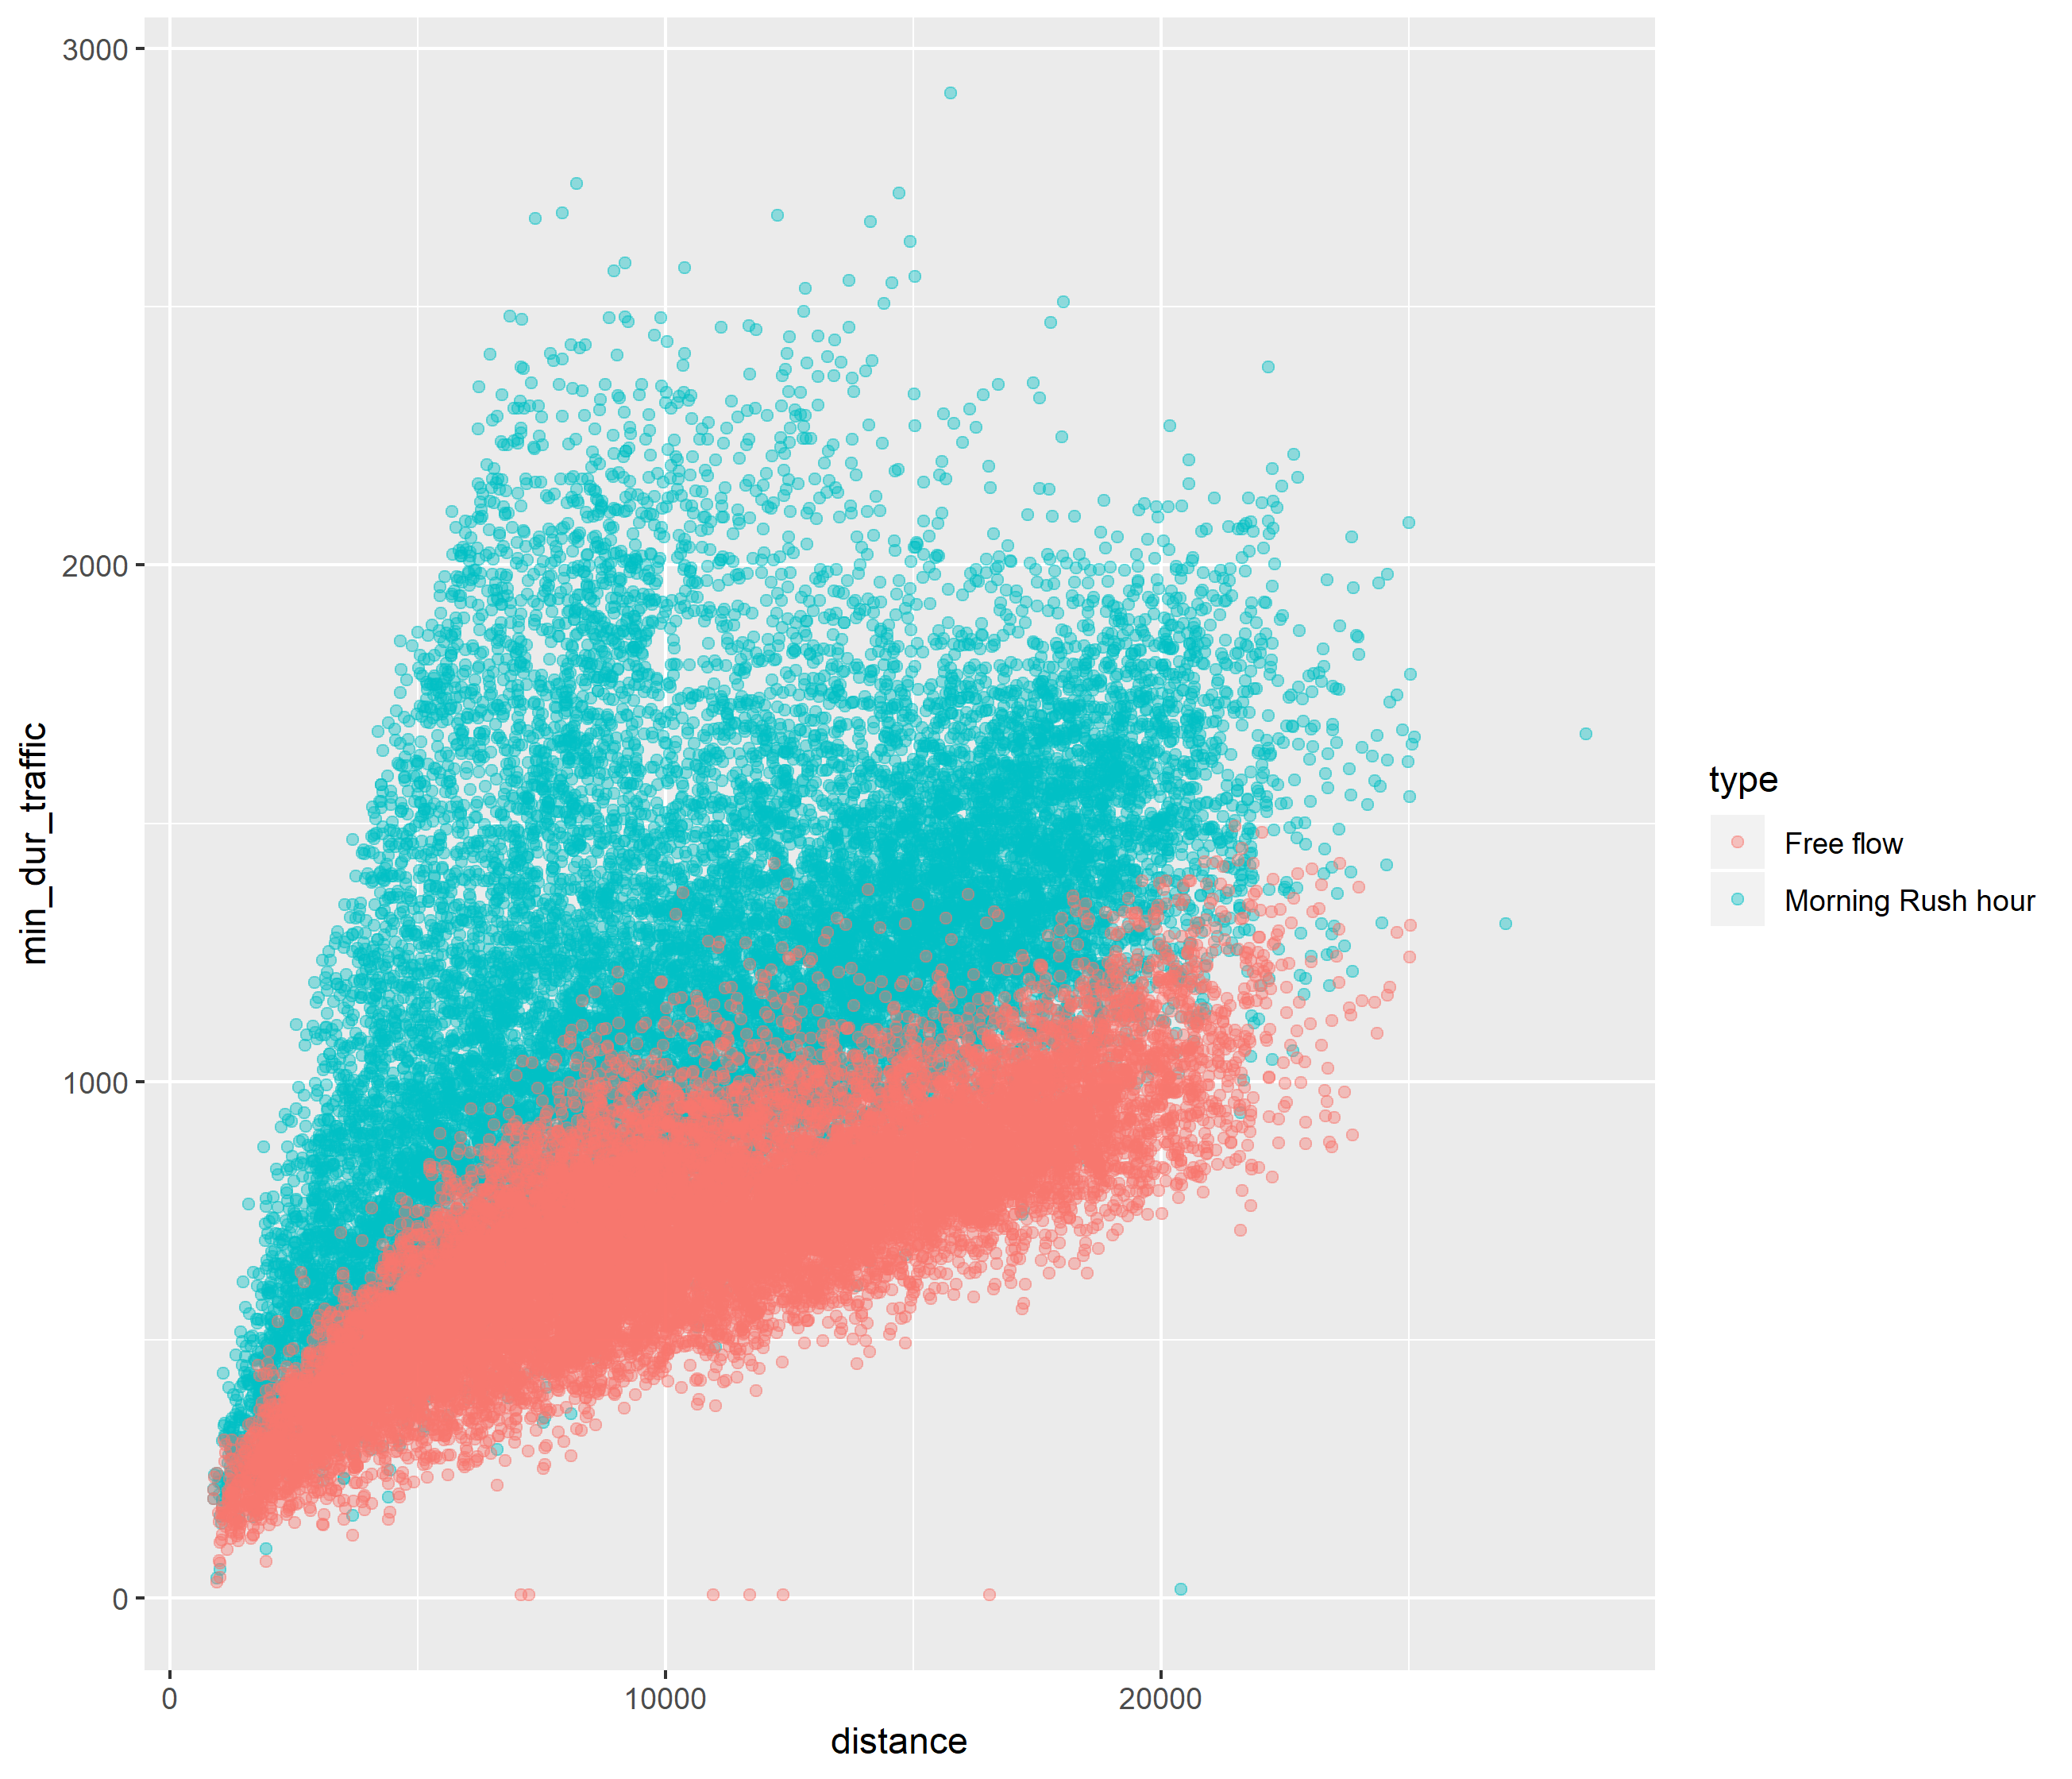
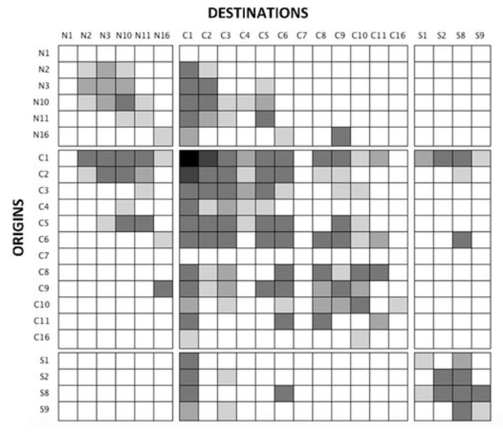
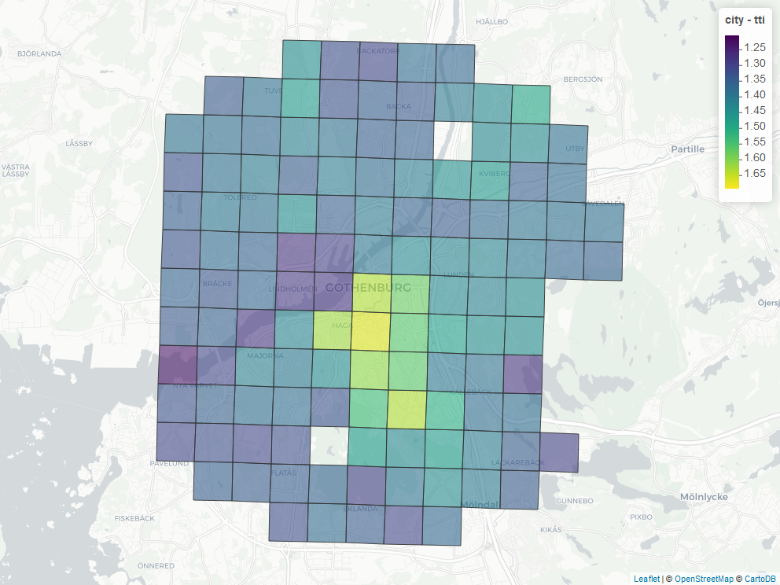
Methodology
Define study area & sub-divide it
Create list of all potential trips
Extract travel time and distances
Process data captured
Calculate KPIs and visualizations
Time difference
Relative time
TTI
Congested
vs
Non-congested
130 zones
130*129 trips
2*(130*129) trips
35,000 trips

Slide 8
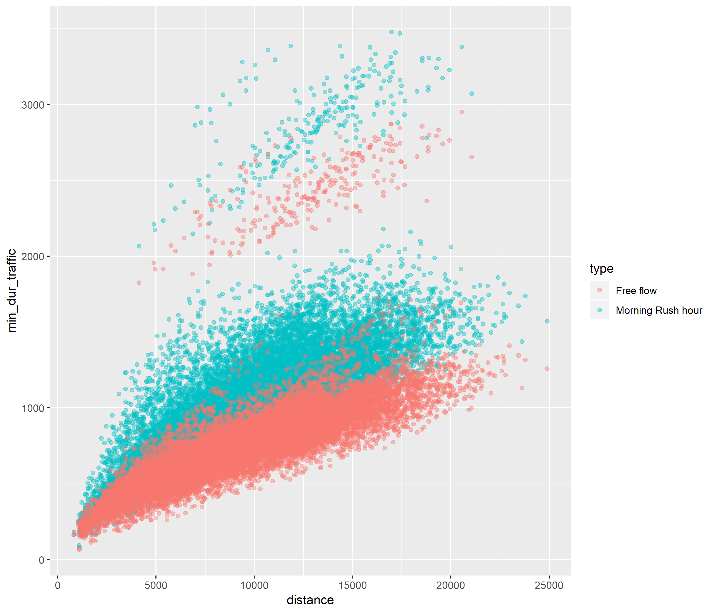
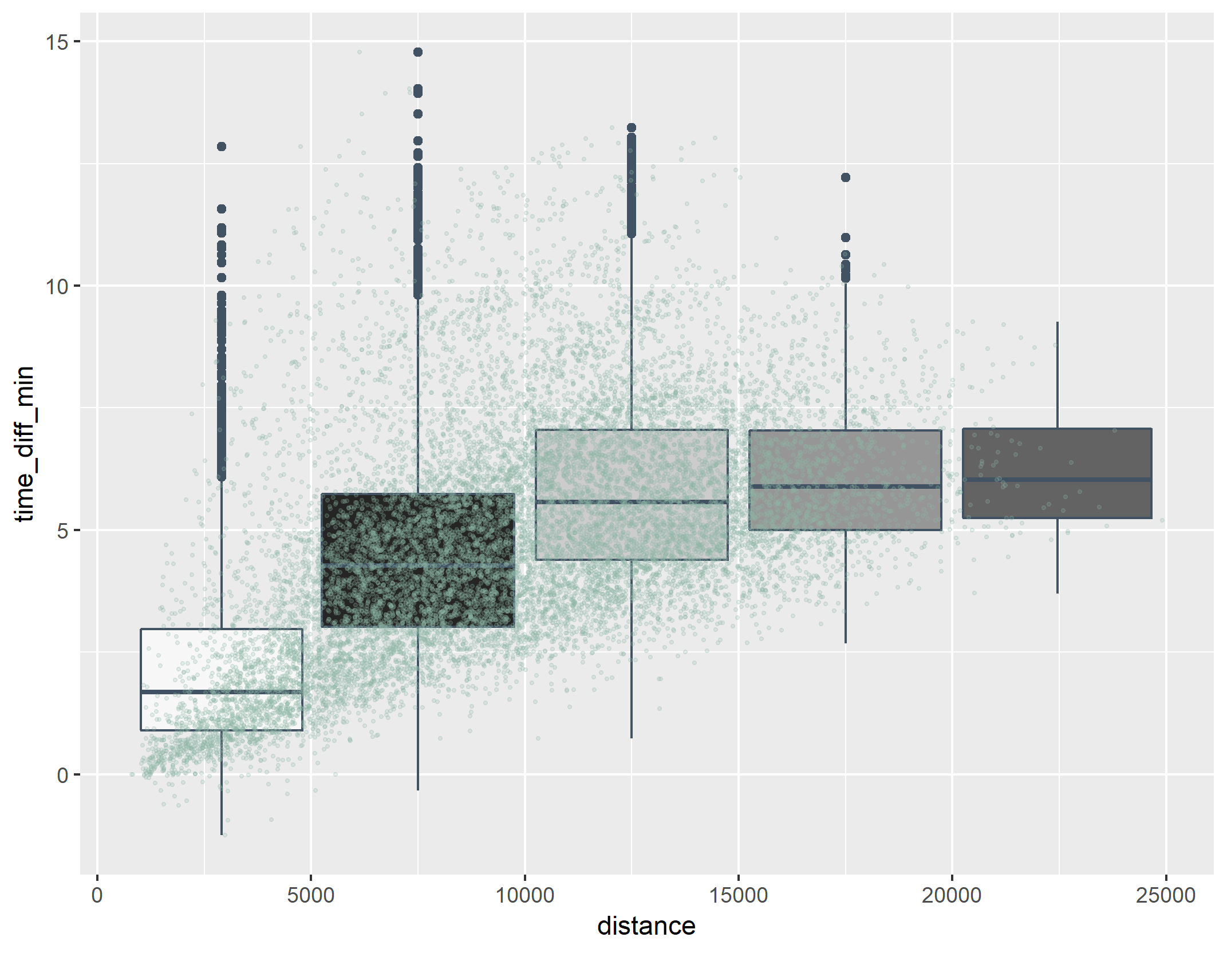
Results: Göteborg
Extract travel time and distances
Process data captured

Slide 9
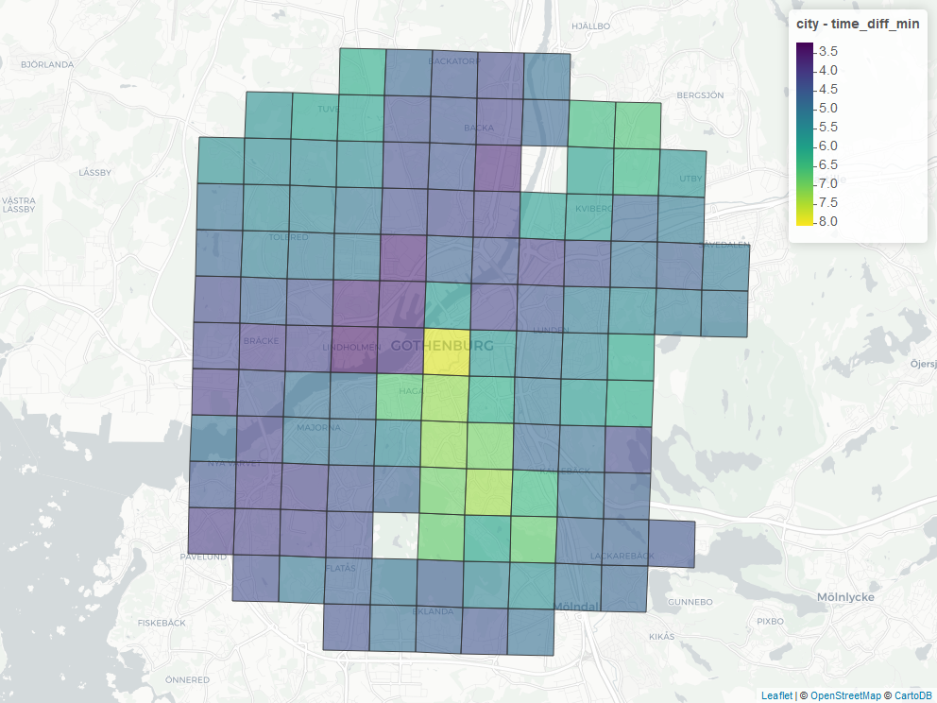
Results: Göteborg
Calculate KPIs and visualizations
Time difference
TTI
Time difference = Average (Congested time – NonCongested time)
TTI = Average (Congested time / NonCongested time)

Slide 10
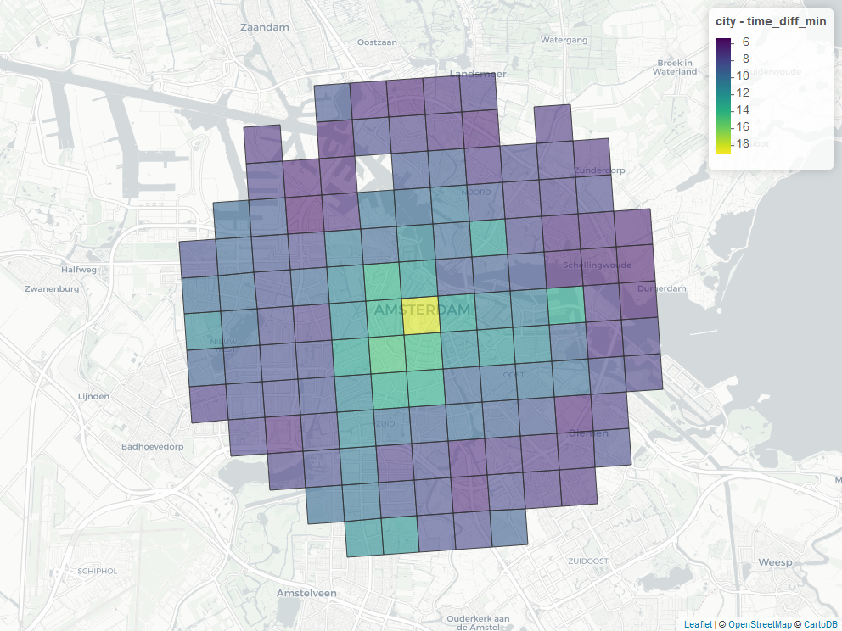
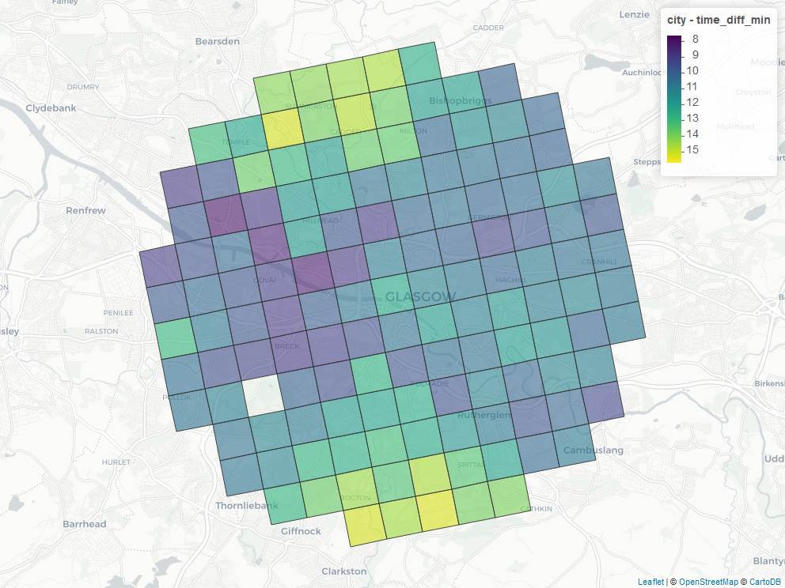
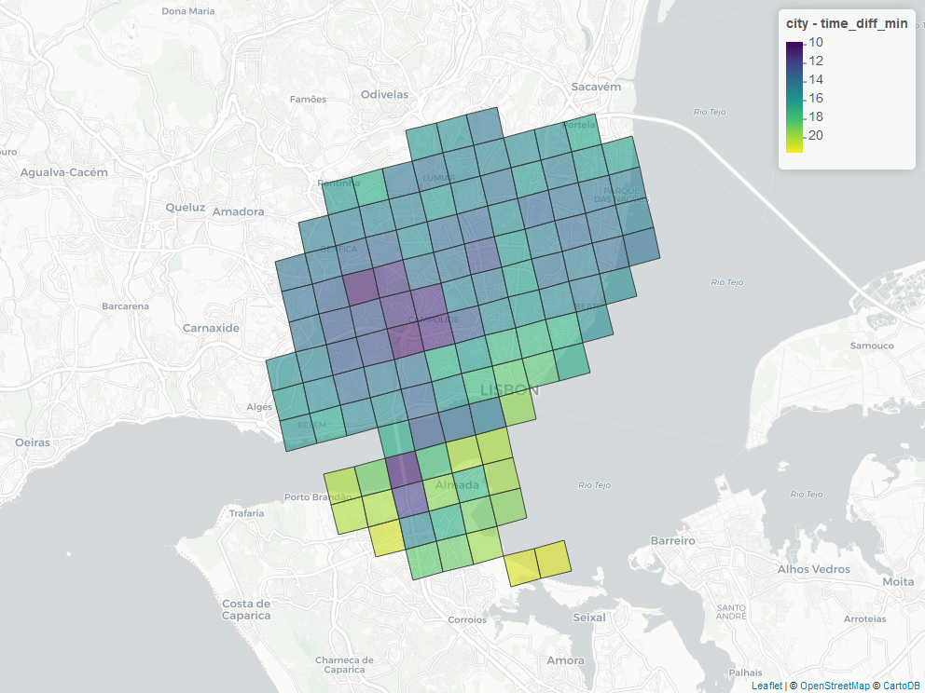
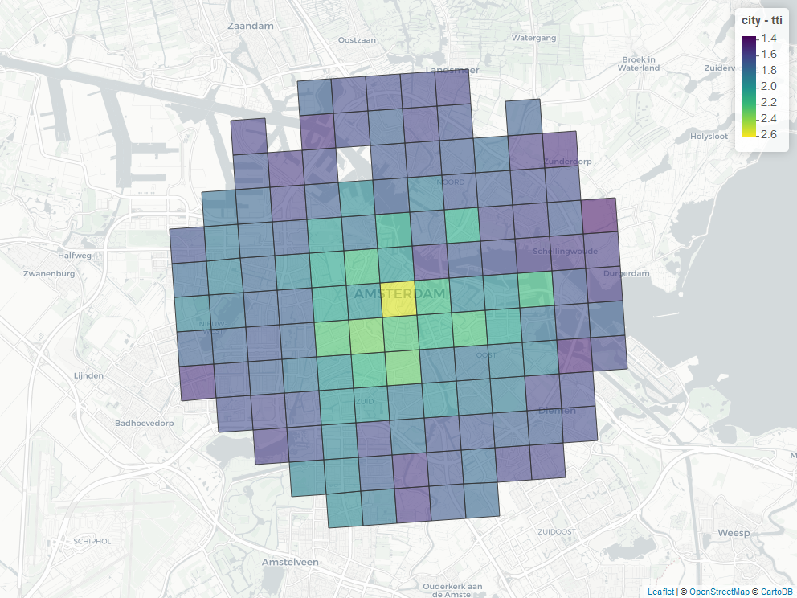
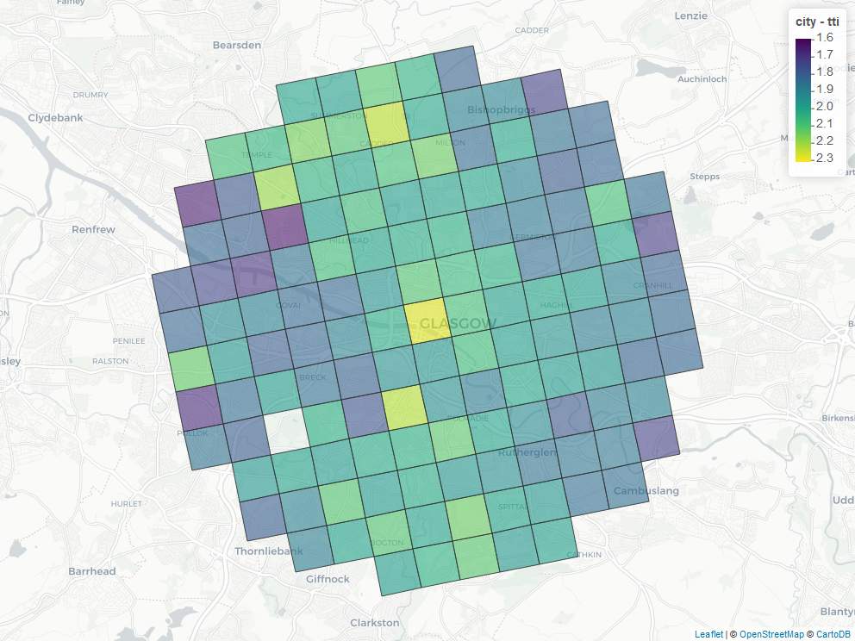
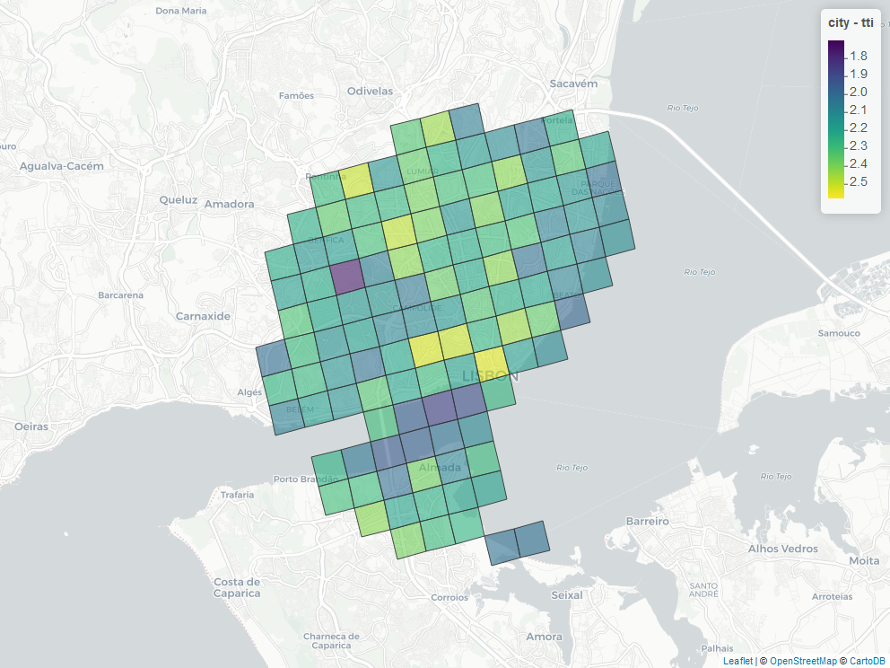
Results: multiple city profiles
AMSTERDAM
GLASGOW
GOTEBORG
LISBON
Time difference
TTI
Notes:
The bigger the badder

Slide 11
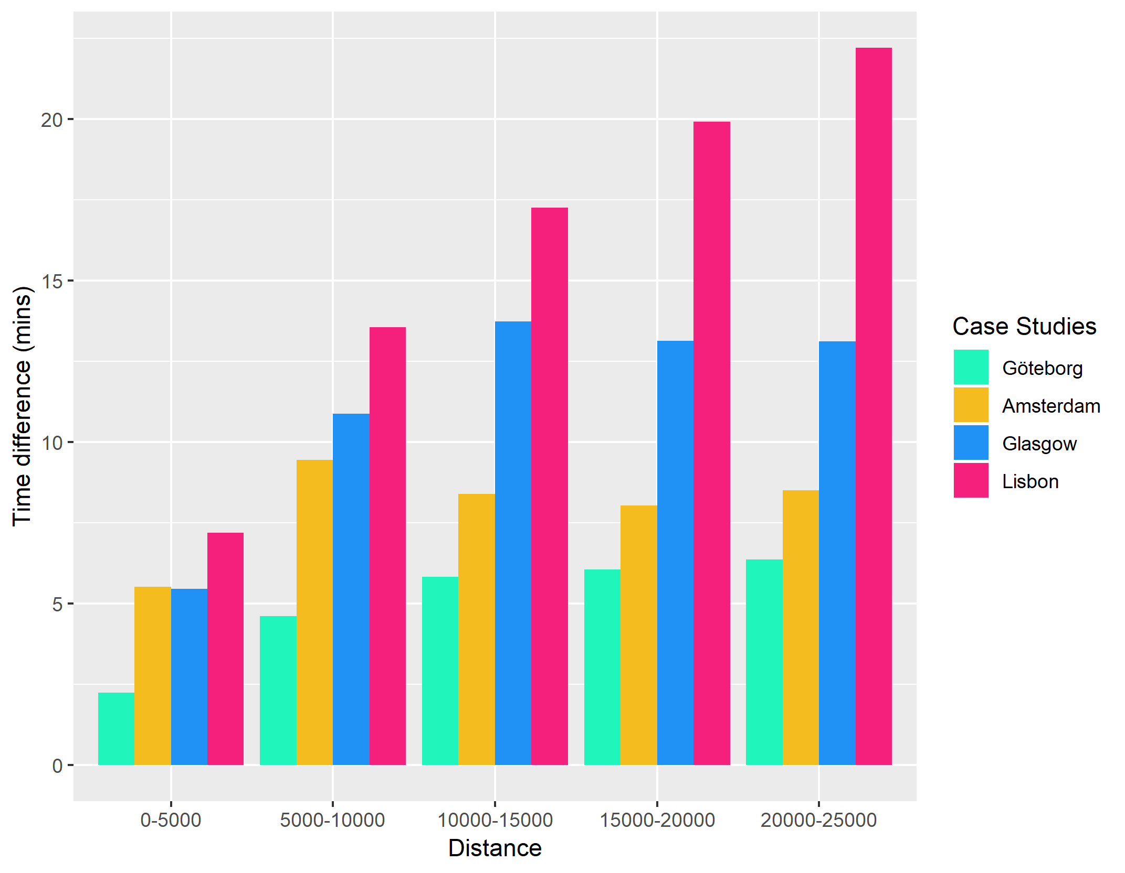
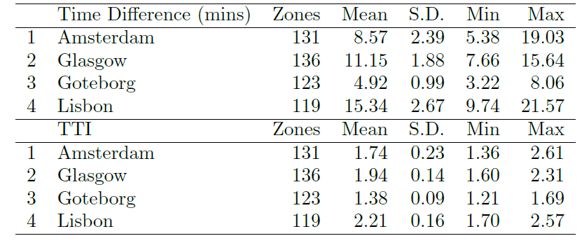
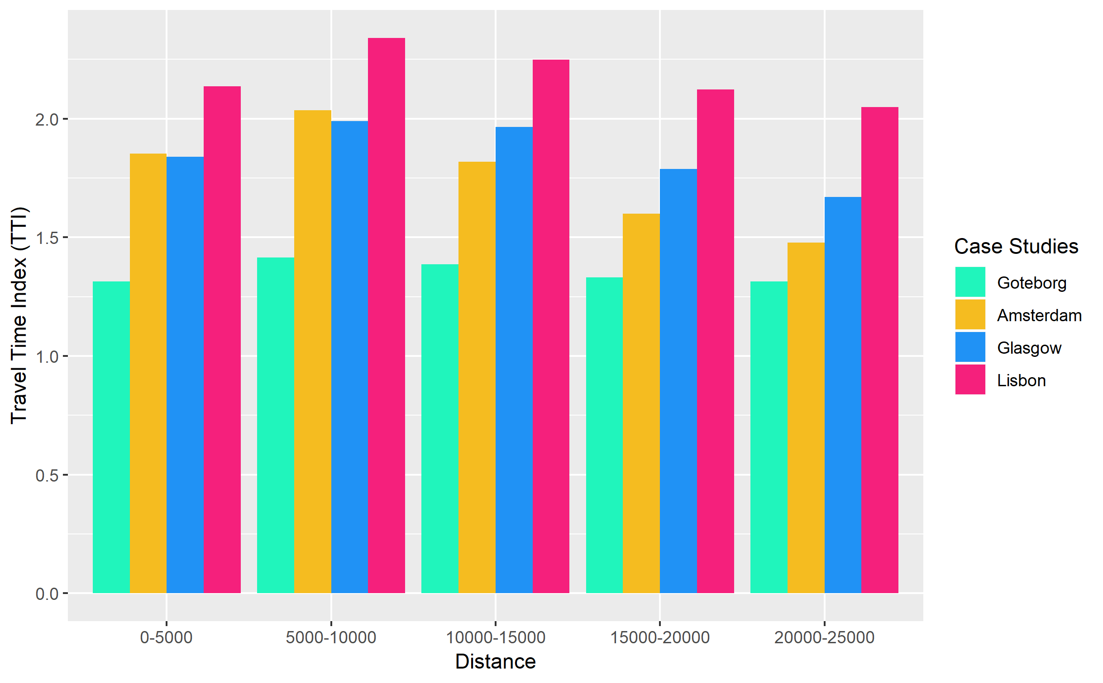
Results: comparing cities

Slide 12
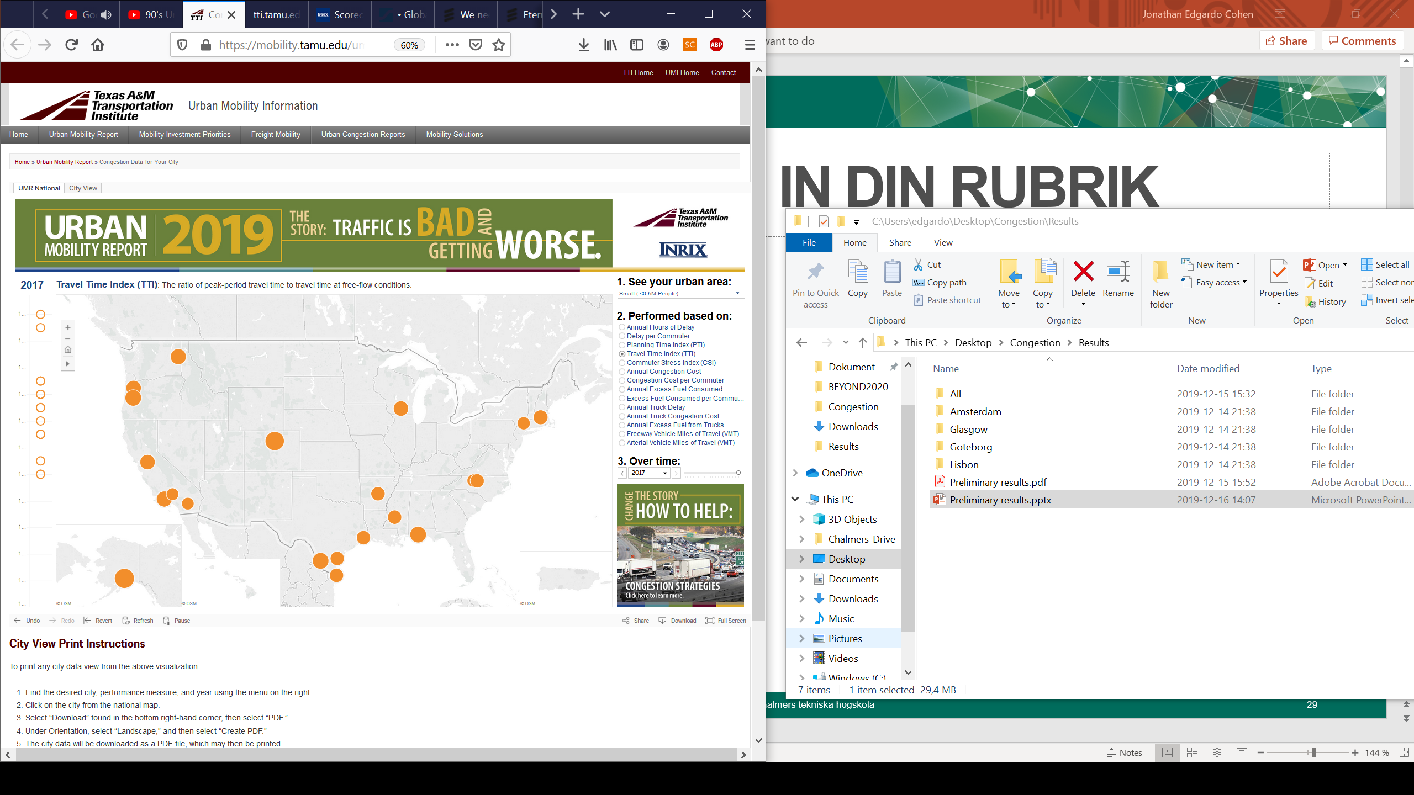
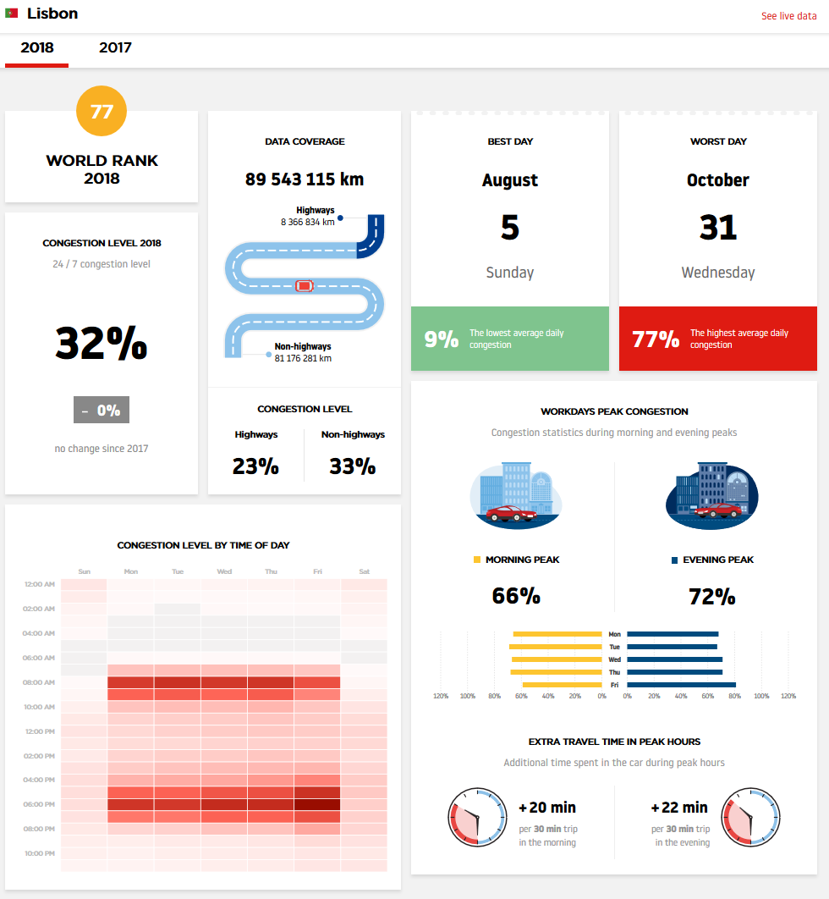
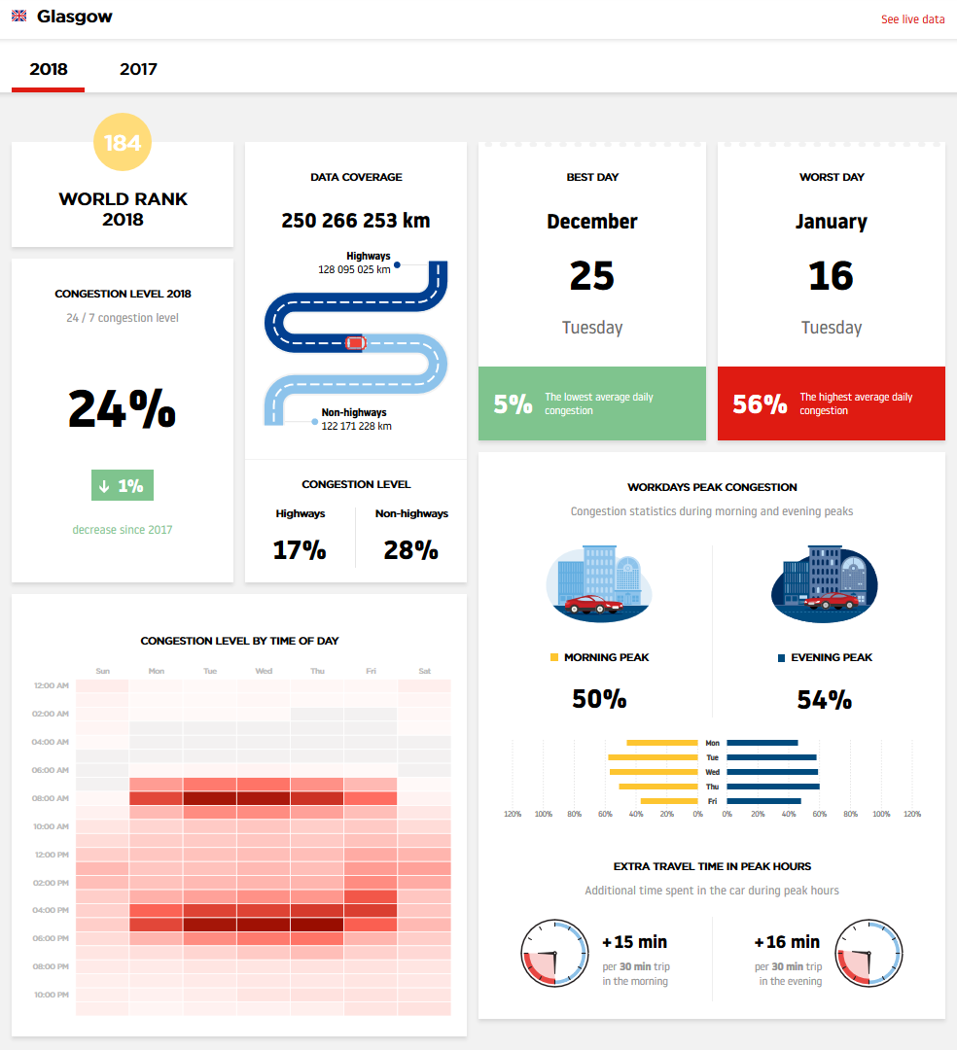
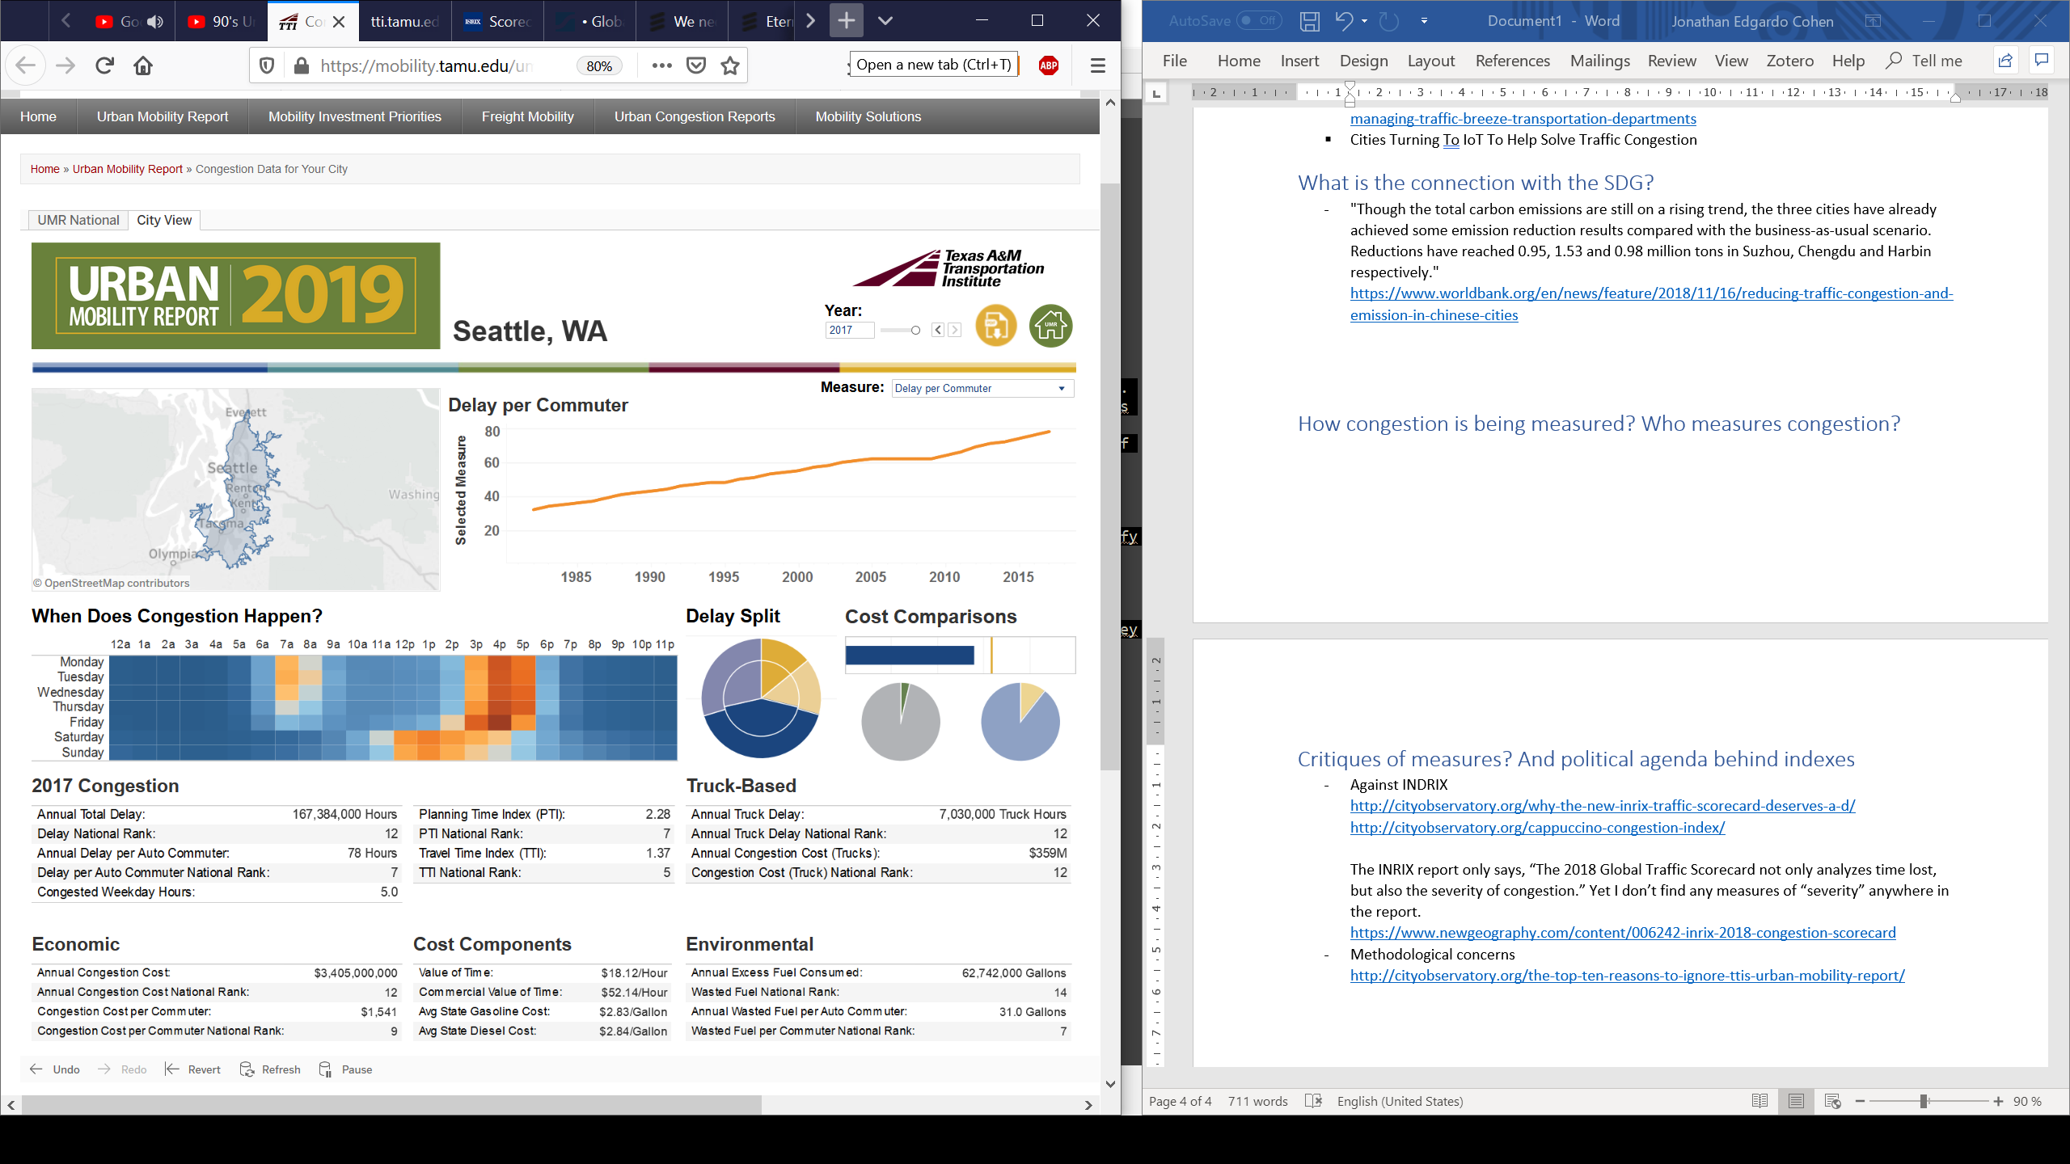
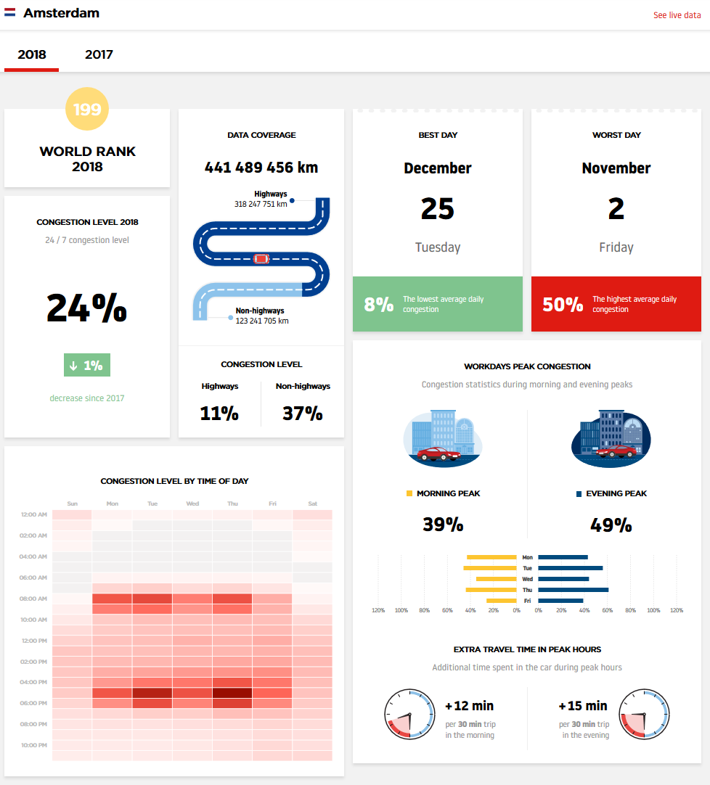
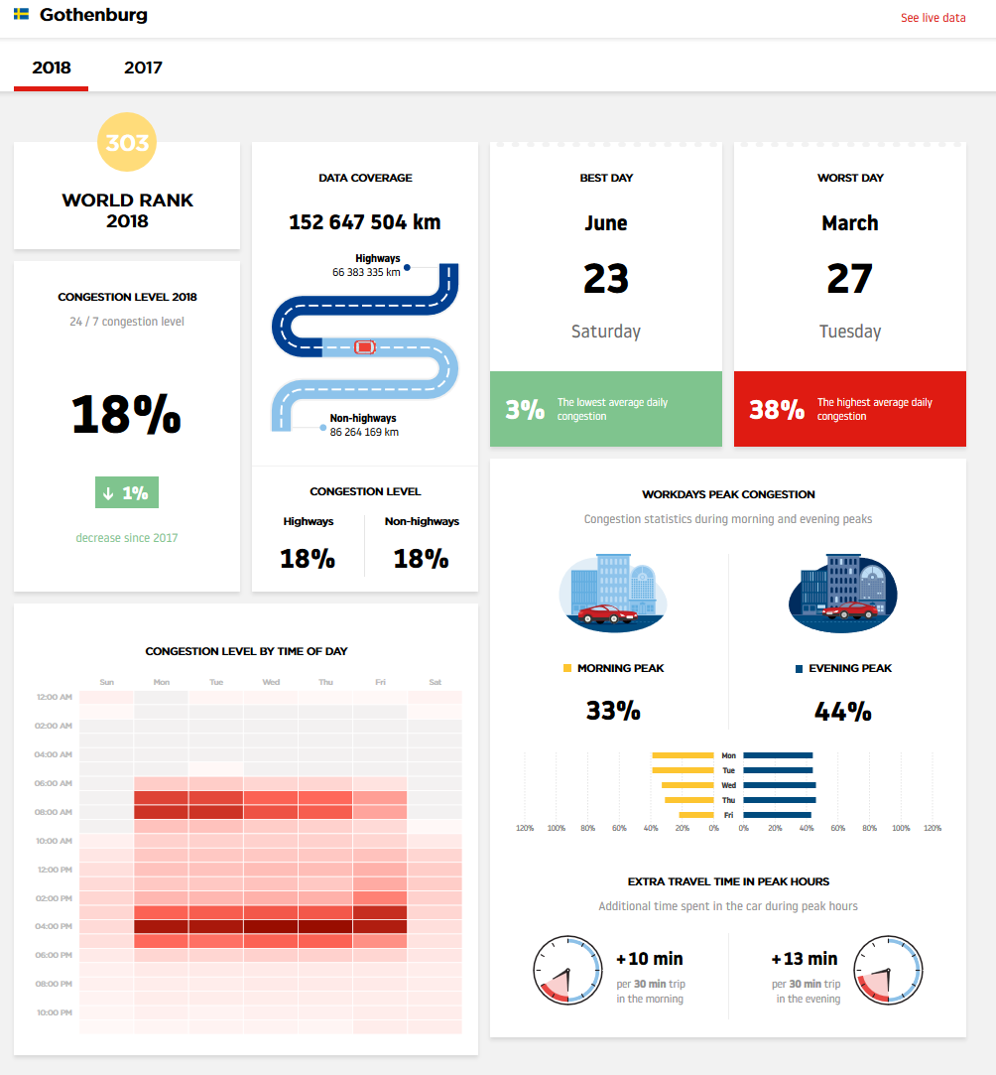
Validation
http://inrix.com/scorecard/
https://www.tomtom.com/en_gb/traffic-index/ranking
Notes:
Make smaller and put our char to the left

Slide 13
Limitations
No control over the service (Google) costs, availability or standards
Only car movements are considered
Assumes equal importance of every trip
Future Work
Test other traffic provider services such as HERE
Extend it to other transportation modes
Use of other geographical boundaries
Weight the KPIs with OD Matrix (travel demand)
Notes:
Including census can contribute to have a clear understanding of who is affected

Slide 14

Thank for listening
Contact information
Cohen, Jonathan: jonathan.cohen@chalmers.se
Gil, Jorge: jorge.gil@chalmers.se

